Slide 1
Chapter 2
Web Development Using HTML
Notes:
Lecture slides prepared for “Computer Organization and Architecture”, 10/e, by William Stallings, Chapter 2 “Performance Issues”.

Slide 2
Objectives
After success completion of the chapter you will be able to:
Identify the core web development technologies
Understand the HTML document structure and contents models.
Identify and use HTML elements and attributes
Build website using HTML

Slide 3
Outline
The core Web development technologies
What HTML is and is not.
The evolution of HTML
Structure of HTML Document
Anatomy of HTML elements
HTML Content Models
Introduction to developer tools
Tips
HTML standards documents
Validation service
Learning resource

Slide 4
Outline
Document structure and metadata elements
Text markup elements
Image elements
Link elements
Table elements
Working with Form (elements and controls)
Interactive elements
Multimedia Elements
Embedded Elements
Graphics (SVG) and MathML elements

Slide 5






1. The core Web development technologies
HTML, CSS and JavaScript are the basic building block and core web development technologies.
HTML
CSS
JavaScript
Structure
Crate the structure of the website
Presentation
Stylize the layout of the website
Behavior
Add interactivity to the website

Slide 6
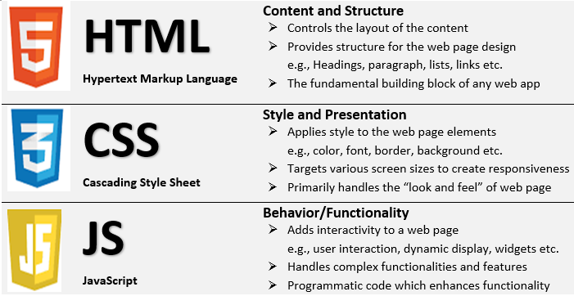
Cont’d
Summary of the difference between HTML, CSS and JS

Slide 7
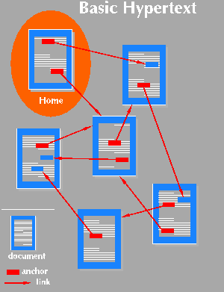
2. What HTML is and is not?
HTML Stands for Hypertext Markup Language
Hypertext
Hyper is the opposite of linear
Hypertext basically refers to Non-sequentially linked pieces of text or other information which is also called “Nodes”.
More specifically it is the way in which Web pages (HTML documents) are linked together.
Goal
Allow to access and read text and other information from multiple perspectives.

Slide 8
Cont’d
Markup Language
Markup originally refers to the handwritten indicators on an author’s manuscripts.
The idea of markup Notify a typesetter the layout of a document and the typeface to use
A markup language is a set of characters or symbols that define a document’s logical structure.
In other words, it refers to the use of set of characters within a piece of information that can be used to process or identify that information in a particular way
It composed of set of symbols called markup tags.

Slide 9
Cont’d
HTML (Hypertext Markup Language)
It is a markup language which based on Standard Generalized Markup Language (SGML).
SGML is a standard for specifying a markup language or tag set.
SGML Itself is not a document language, but a description of how to specify one and create a document type definition (DTD).
It define the structure of information on the Web page.
It doesn’t describe the actual presentation of a document
It tells the web browser what content to display.
Use a pre-defined set of tags to identify the webpage content types .
It is not a programming language.

Slide 10
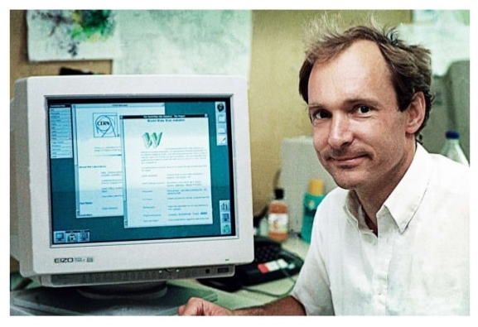
3. The evolution of HTML
Before 1990 there was no easy way to find, download and view documents over the internet.
HTML, initially invented by in 1991 by Tim Berners Lee.
Tim invented a system – the web (WWW)
Store documents in one central place (i.e. a web server)
Make it possible to download and view a document with a single click (i.e. a web browser)
Allow to find new documents by clicking on “links” inside other documents.
Instead of licensing and selling his idea, he made free for every one

Slide 11
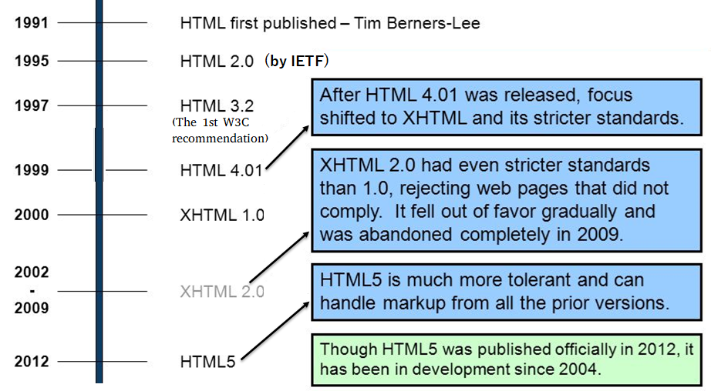
Cont’d
History of HTML

Slide 12
Cont’d
HTML Standardization history
Before 1997, there were no HTML standards, so browsers basically did whatever they wanted.
Particularly 1993 – 1997 (The “War” Years), HTML was being defined by the elements that browser software developers chose to implement.
They invented new tags or implemented the same tags differently which was kind of the wild west of the web.
Around 1997, the W3C came up with the first standard that browsers started to pay attention to.
The W3C defined HTML version 4 (or HTML4) which it shortly thereafter updated to HTML4.01.

Slide 13
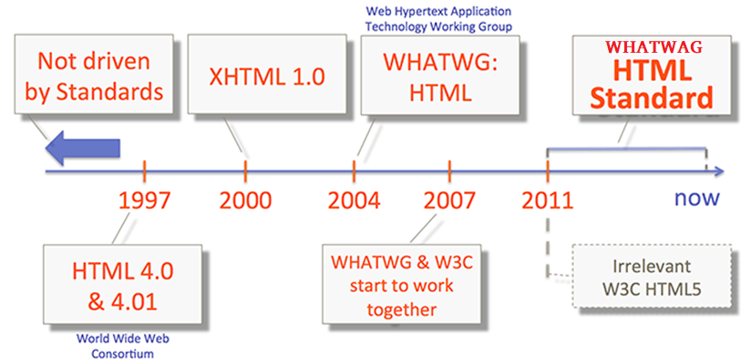
Cont’d
HTML Standardization history
Continuously evolve the HTML standards and the only exclusively in charge of HTML
Because it wants to publish a frozen specification for HTM5
Note:
W3C is the main international standards organization for the Web
WHATWG – established in 2004 by the browser vendors

Slide 14
Cont’d
HTML5
Current version of standard HTML which was defined in 2012 by WHATWAG.
It is cross-platform. It will display content on a desktop computer, laptop, a tablet, smartphone, a notebook or a Smart TV.
All major browsers support most of the HTML5 elements.
Key features
Multimedea elements
Graphics elements
Offline support
Semantics markups

Slide 15
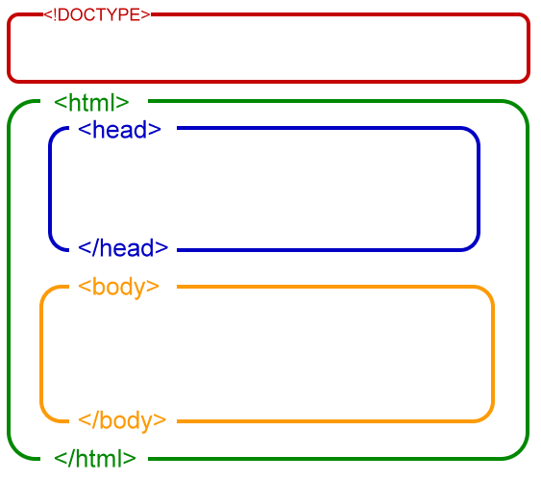
4. Structure of HTML Document
Basically the HTML document is divided into head section and body Section.
Tell the browser the type of HTML standard
Must appear first
Contain html document meta info, links, style sheet and scripts etc.
These are non web displayable info
Contains the content that displays in the browser

Slide 16
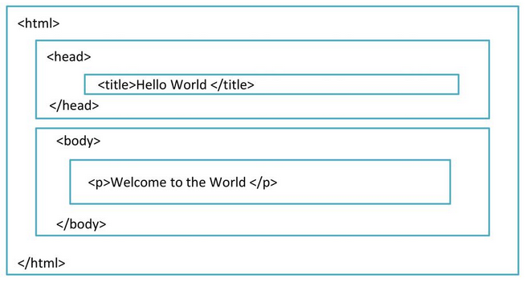
Cont’d
Example

Slide 17
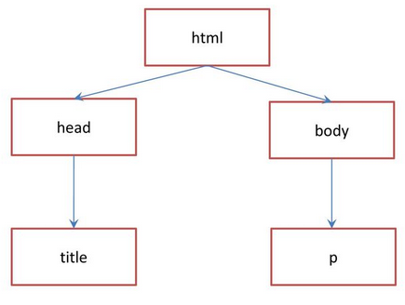
Cont’d
Tree structure of HTML Document
Document (root) element
Document metadata element
Section element (root sectioning)

Slide 18
Cont’d
Inside the body section
Inside the head section
Text formatting
Links
Table
From
Images and multimedia
Embedded elements
Interactive elements
Graphics etc.
Title
Style
Script /no script
Meta
Link
base

Slide 19
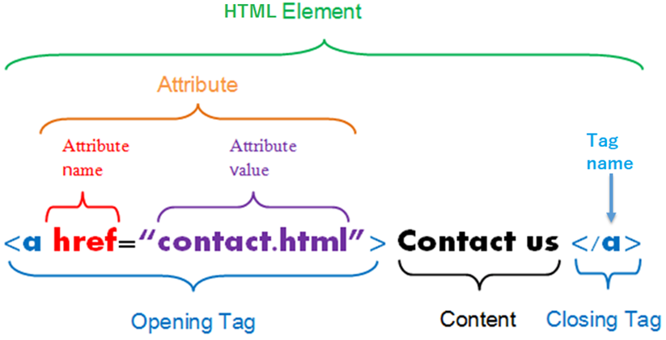
5. Anatomy of HTML Elements
Syntax:
<tag attribute = “Value”> Content </tag>

Slide 20
Cont’d
HTML elements
Represent some kind of structure
It is a combination of a tag and its character data (content)
HTML can be Empty element or Nested element also
Nested Element
An element that contain other HTML elements
Empty Element
An element with no character data (content)
Also called Non-container tags or self closing tags
Syntax: <self-closing-tag-name/>

Slide 21
Cont’d
HTML Tags
Used to markup the text (content)
Most of the tags come in as start and end tag pairs
However, empty element tags doesn’t come in pairs
The start tag may contain an attribute.
HTML attributes
Defines a property for an elements
It is a way to describe the tags
It must enclosed within the start tag.
It comes in a name/value pairs
The value should enclosed within double quote
An element can have one or more attributes
Global attributes - common to all HTML elements

Slide 22
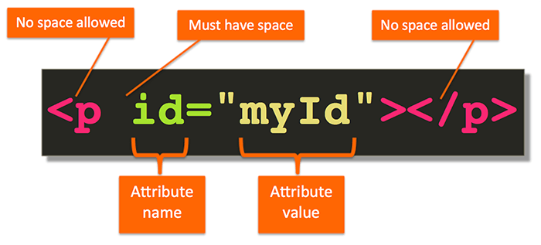
Cont’d
Tip (simple rule)
Also:
Don’t forget the End tag.
Even though HTML is case insensitive use lowercase Tags

Slide 23
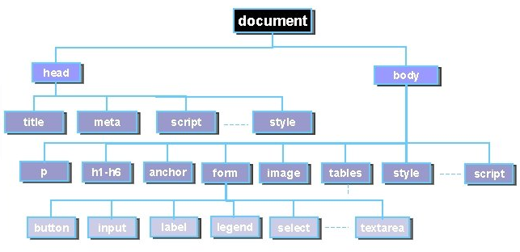
Cont’d
Basic HTML document elements hierarchy
: a showcase

Slide 24
Cont’d
HTML elements reference
The HTML elements are grouped by function to help you find what you have in mind easily.
For details of each element under the below mentioned group just ctrl +click on the element category.
Document metadata
Sectioning root
Content sectioning
Text content
Inline text semantics
Image and multimedia
Embedded content
SVG and MathML
Scripting
Demarcating edits
Table content
Forms
Interactive elements
deprecated elements

Slide 25
6. Content Model in HTML
Content Model refers to the set of rules that define what type of content each element is allowed to have.
Mostly, this translates into what other elements are allowed to be nested inside which other elements.
Prior to the modern HTML specification, HTML elements were either block-level or inline elements.
Modern HTML specification split these two content models into seven basic models.
However, in practical terms, you can still think of those seven models as falling into the same traditional categories: block-level and inline elements.

Slide 26
Cont’d
Block-level Elements
By default, Block-level elements render (displayed) to begin on a new line (i.e. the browser will automatically place the contents of that element on a new line in the flow of the document.
Inline Elements
Render on the same line by default.
Having new line characters in the content or between the tags in your code won’t make any difference.
All those space characters get translated into a single space anyway and the whole bunch of inline elements still be displayed on the same line.
Inline elements are restricted to only contain other inline elements

Slide 27
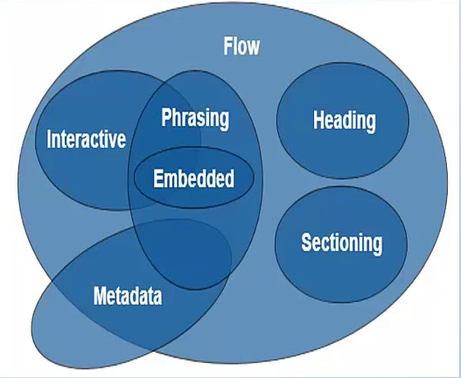
Cont’d
Modern HTML Content Models
Each elements in HTML5 falls into zero or more categories that group elements with similar characteristics.
The following broad categories are used in the current HTML specification:
Metadata content
Flow content
Sectioning content
Heading content
Phrasing content
Embedded content
Interactive content
Some Elements are Overlaps

Slide 28
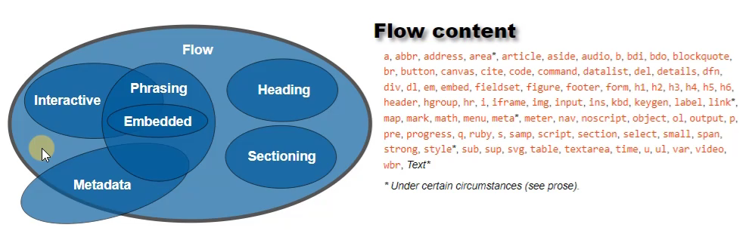
Cont’d
Kind of Content

Slide 29
6. Browser Developer Tools
Every modern web browser includes a powerful suite of developer tools.
Also called web development tools or devtools or inspect element
These tools do a range of things, from inspecting currently-loaded HTML, CSS and JavaScript to showing which assets the page has requested and how long they took to load
With developer tools, we can directly interact with the source code that is fetched into the client side of our system.
Allow to understand the underlying structure of the code
Enables us to inspect the web content

Slide 30
Cont’d
These are the tools that are browser dependent.
Come as browser add-ons or built-in features in web browsers.
Most popular web browsers, such as Firefox, Google Chrome, Internet Explorer, Safari, Microsoft Edge and Opera have built-in tools
Moreover, many additional add-ons can be found in their respective plugin download centers.
Across all browsers, the basic functionality of the developer tools remains the same, only naming conventions and terminologies changes.
For details how to use the developer tools the refers to the link below under the Tools and setup
https://developer.mozilla.org/en-US/docs/Learn/Common_questions

Slide 31
Tips
HTML standards documents
HTML Living Standard
https://html.spec.whatwg.org/multipage/#toc-semantics
A vocabulary and associated APIs for HTML and XHTML (W3C Working Draft 25 May 2011)
http://www.w3.org/TR/2011/WD-html5-20110525/
MDN Web Docs - Resources for developers, by developers
https://developer.mozilla.org/en-US/
Validation service
https://validator.w3.org/

Slide 32
Tips
Learning resources
W3Schools
https://www.w3schools.com/html/default.asp
Code Academy
https://www.codecademy.com/
FreeCodeCamp
https://www.freecodecamp.org/
Tutorials to Night
https://www.tutorialstonight.com/
MOOCs
HTML CSS JavaScript course for Web Developers by Coursera
Basics of Web Development by Coursera
Zero to Mastery course by Udemy

